Slide 1
Control Engineering
Lecture 7

Slide 2
A note on phase and gain margins (stability margins)
What is a margin?
  The extra gain or phase in the open loop system that we can use before the system goes unstable.
  Mathematical model vs actual process

Slide 3
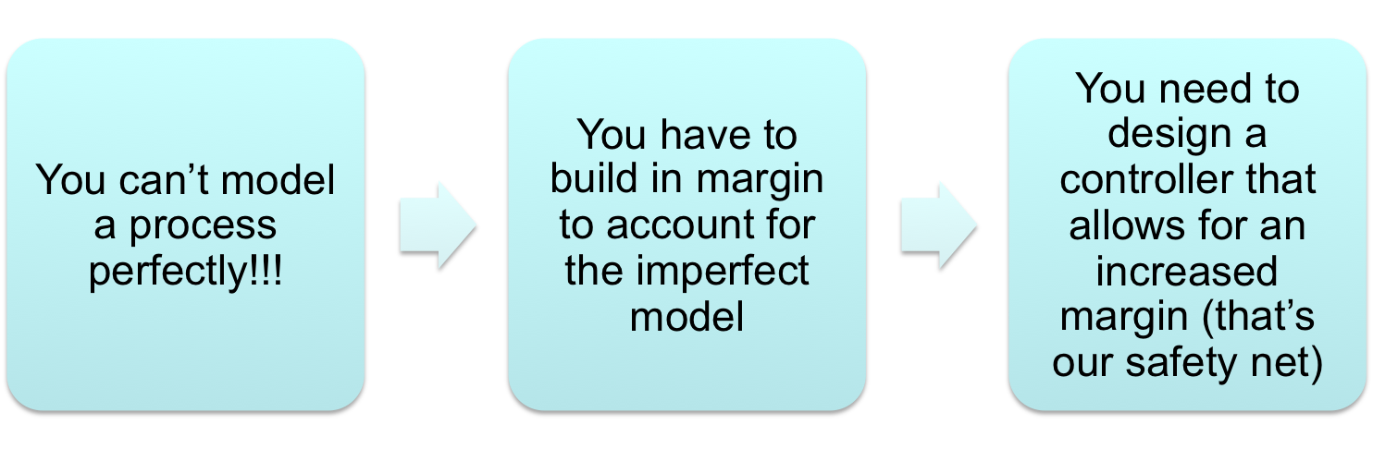
A note on phase and gain margins (stability margins)
What is a margin?
  The extra gain or phase in the open loop system that we can use before the system goes unstable.
  Mathematical model vs actual process (how much can the process vary before our designed controller makes the closed loop system unstable)

Slide 4
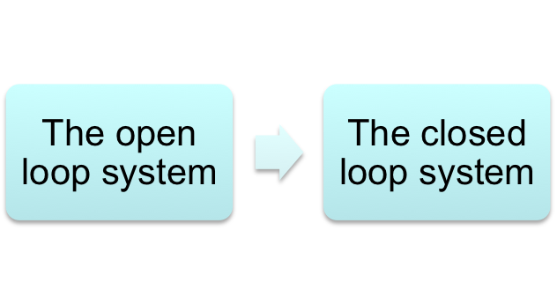
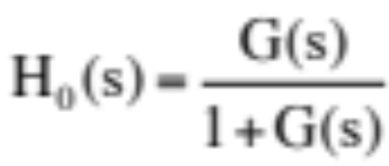
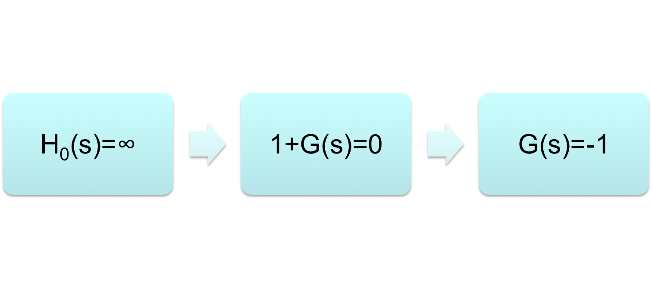

A note on phase and gain margins (stability margins)
What open loop characteristics make a closed loop system unstable?
Gain of an unstable closed loop system is ∞

Slide 5
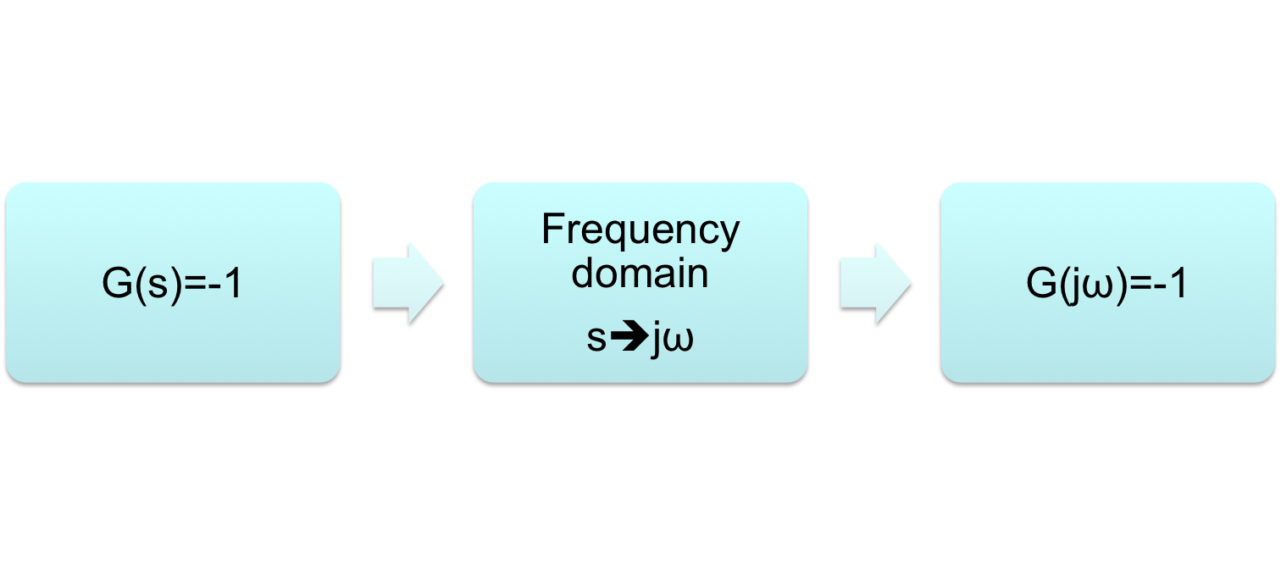
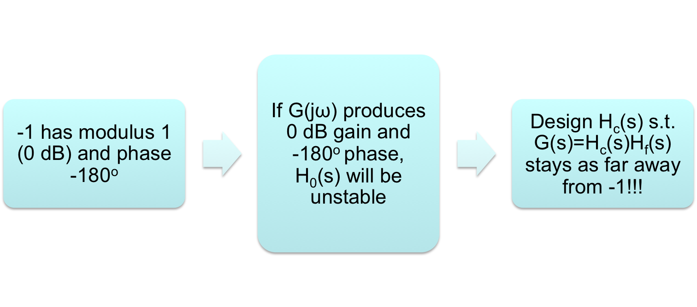
A note on phase and gain margins (stability margins)

Slide 6
A note on phase and gain margins (stability margins)
How far away?
That’s the margin!!!

Slide 7
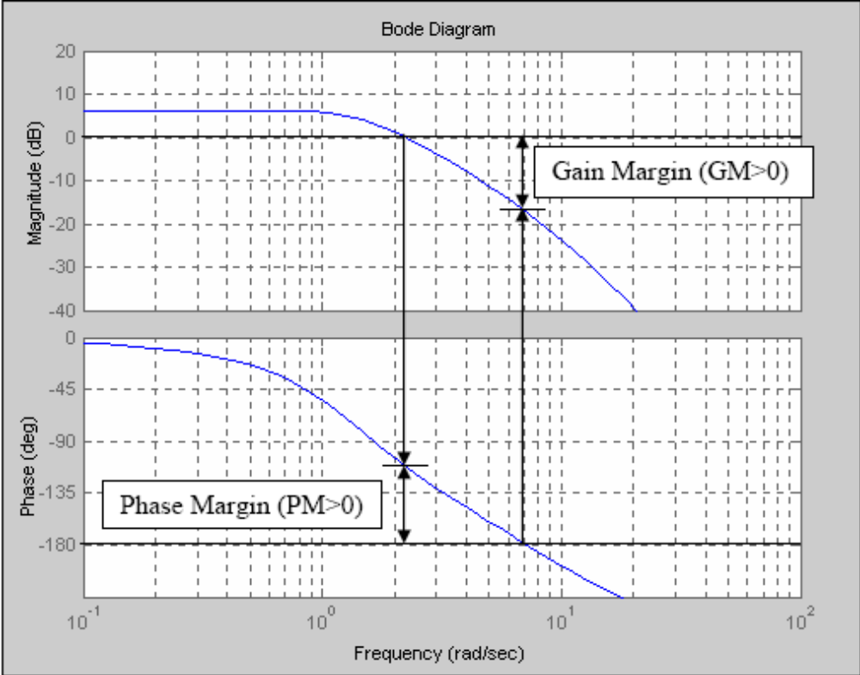
A note on phase and gain margins (stability margins)
A nice video tutorial on this:
https://www.youtube.com/watch?v=ThoA4amCAX4

Slide 8
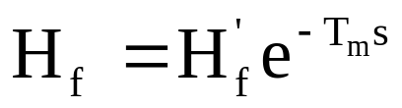
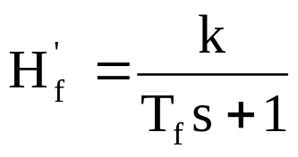
Frequency design methods
For process transfer function

Slide 9
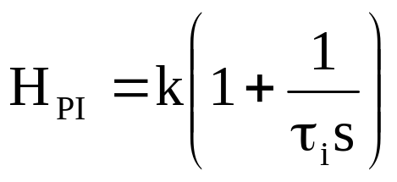
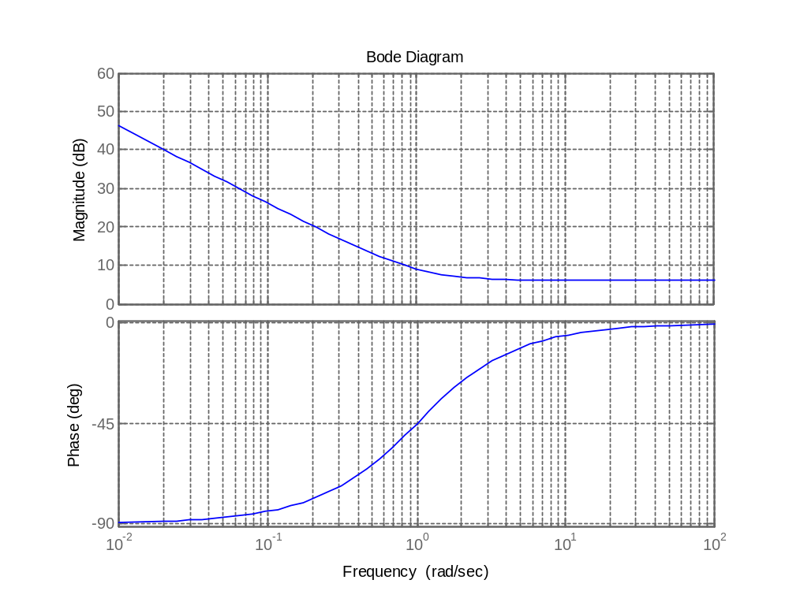
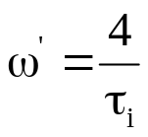
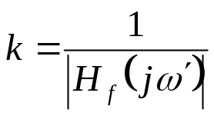
Frequency design methods
Design of a PI controller

Slide 10
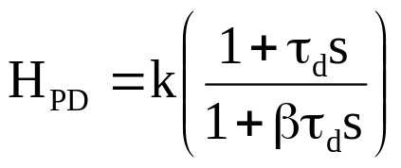
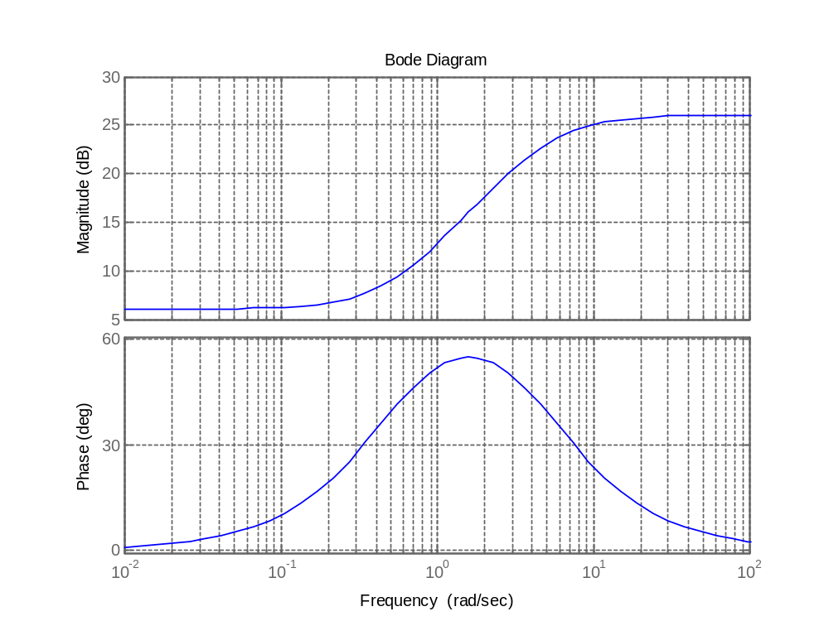

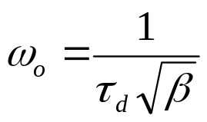
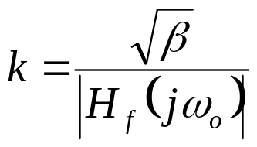
Frequency design methods
Design of a PD controller

Slide 11
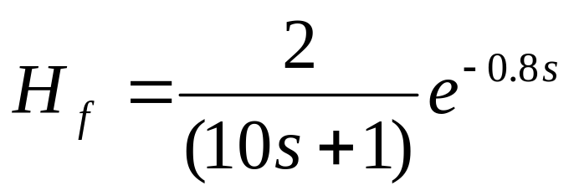
Example
Design a PI and a PD controller to ensure 50º phase margin for the process described by

